Slide 1


Slide 2

Topics
Refresher on ML and DS workflow
Decision Tree
Gini vs Entropy vs Information Gain
Confusion Matrix
Understanding Precision, Accuracy, Recall, F-measure
ROC-AUC curves

Slide 3
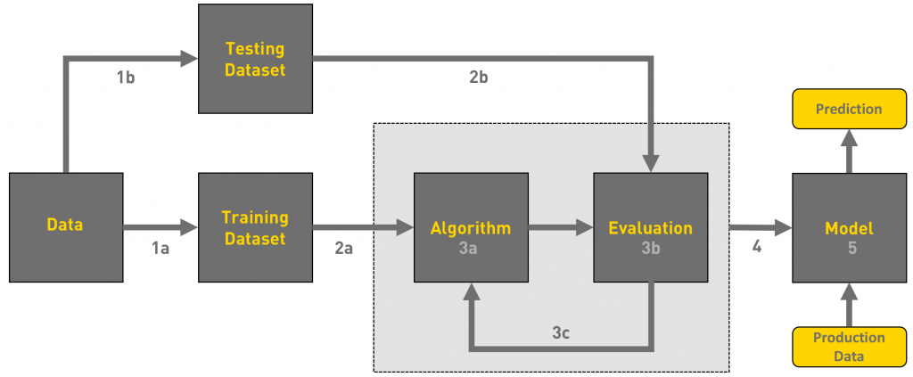
Machine Learning Workflow

Slide 4
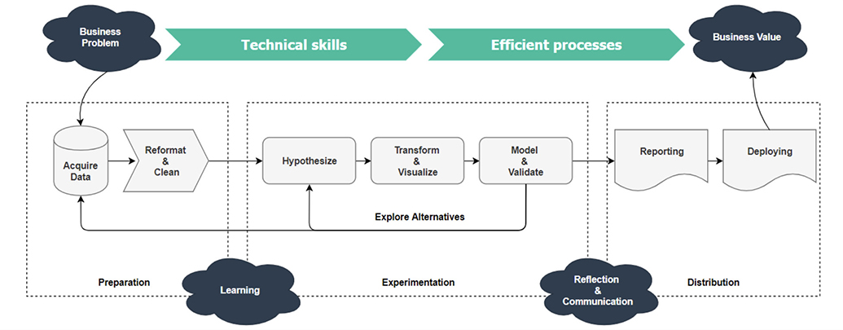
Data Science Workflow

Slide 5

Divide and Conquer
Decision Tree

Slide 6
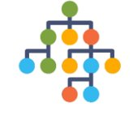
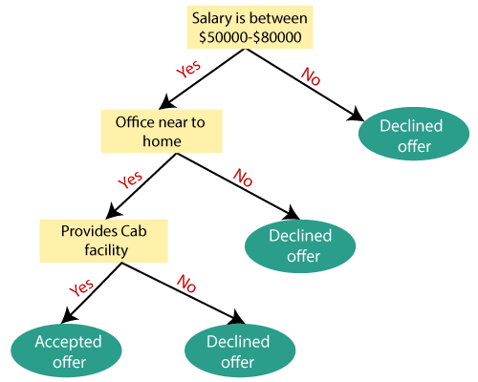
What is Decision Tree?
Decision Tree Algorithms belong to the family of Supervised Learning algorithms. The goal of using a Decision Tree is to create a training model that can be used to predict the class or value of the target variable by learning simple decision rules inferred from historic data.
These decision rules are built based on the Divide and Conquer strategy to corner a particular class from the rest of the data.
Notes:
Based on the given tree, which features would be present in our dataset?

Slide 7

Elements of Decision Tree
Root Node
Splitting
Decision Node
Leaf/Terminal Node
Pruning
Branch/Sub-Branch
Parent & Child Node

Slide 8
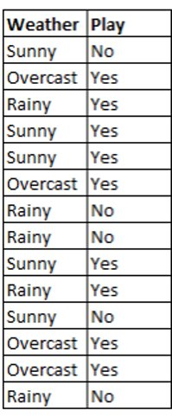
What is Weather Condition
Weather = Sunny
Weather = Rainy
Player will Play the Game
Player will Not Play the Game
Weather = Overcast
Play will Play the Game

Slide 9
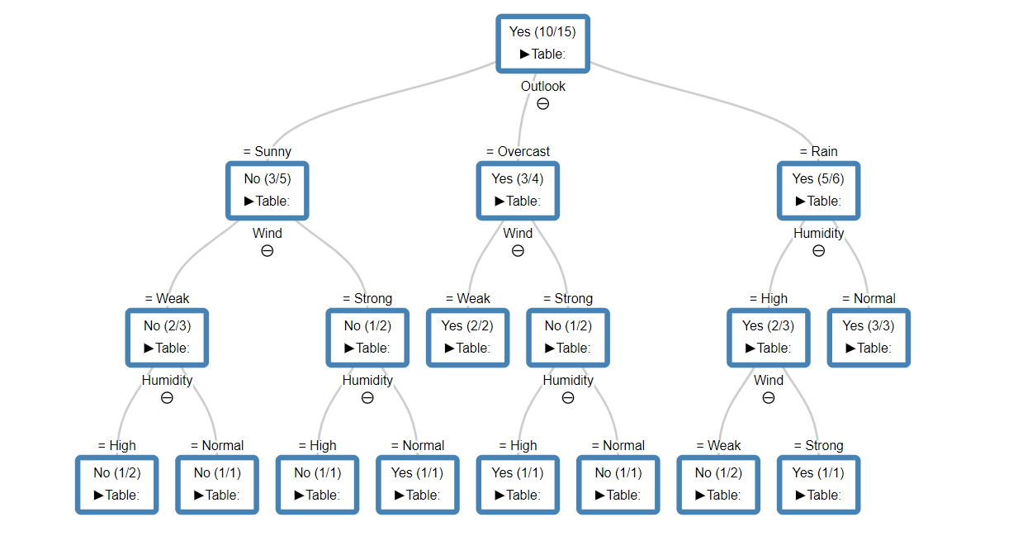
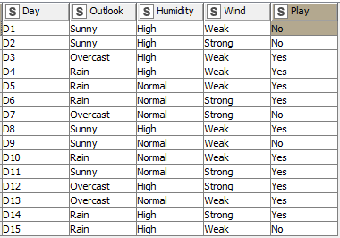
Predictors
Target Variable

Slide 10
Root Node

Slide 11
Splitting

Slide 12
Decision Nodes

Slide 13
Leaf/Terminal Nodes

Slide 14
Sub-Tree / Branch

Slide 15
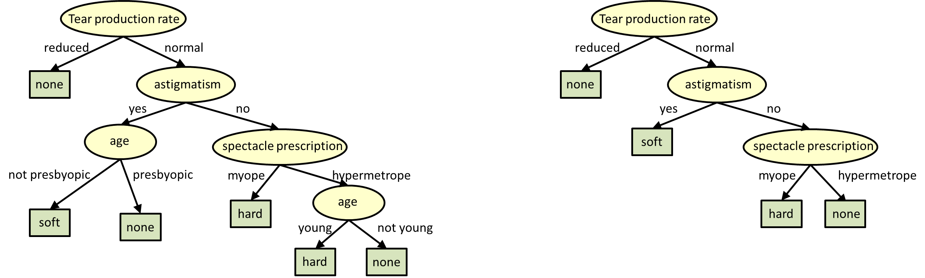
Before Pruning
After Pruning

Slide 16
Gini Index / Entropy / Information Gain
Gini index measures the impurity of a set of samples. It ranges between 0 and 1, where 0 represents a completely pure set and 1 represents a completely impure set.
In decision trees, the Gini index is used to minimize the probability of misclassification at each node. The split with the lowest Gini index is chosen as the best split.
Entropy is a measure of the amount of uncertainty or randomness in a set of samples. It ranges between 0 and 1, where 0 represents no uncertainty and 1 represents maximum uncertainty.
In decision trees, entropy is used to maximize the information gain at each node. The split with the highest information gain is chosen as the best split.
Information gain is a measure of the difference in entropy between the parent node and the child nodes.
The split that maximizes information gain is chosen as the best split. Information gain is often used in conjunction with entropy.
Notes:
Both Gini index and entropy are commonly used in decision trees to measure the quality of a split. The choice between the two depends on the specific problem and data being analyzed. In general, Gini index is preferred when the classes are well balanced, while entropy is preferred when the classes are imbalanced.
It is important to note that the choice of measure does not guarantee the best split, but rather helps to guide the decision tree algorithm towards a split that is likely to produce good results.

Slide 17

Basics of Confusion Matrix
What is Algorithm Prediction?
What is Actual Value?

Slide 18
Basics of Confusion Matrix
What is Algorithm Prediction?
What is Actual Value?
Play = Yes
Play = No
Play = Yes
Play = No

Slide 19
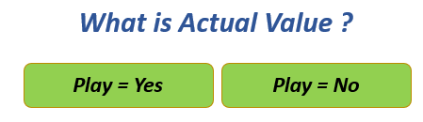
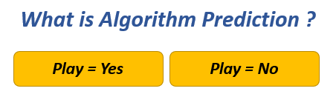
Basics of Confusion Matrix
What is Algorithm Prediction ?
What is Actual Value ?
Play = Yes
Play = No
Play = Yes
Play = No

Slide 20
Basics of Confusion Matrix
What is Algorithm Prediction ?
What is Actual Value ?
Play = Yes
Play = No
Play = Yes
Play = No
True Positive
Actual Play = Yes
Play = Yes

Slide 21
Basics of Confusion Matrix
What is Algorithm Prediction ?
What is Actual Value ?
Play = Yes
Play = No
Play = Yes
Play = No
False Positive
Actual = No
Predicted = Yes

Slide 22
Basics of Confusion Matrix
What is Algorithm Prediction ?
What is Actual Value ?
Play = Yes
Play = No
Play = Yes
Play = No
False Negative
Actual = Yes
Predicted = No

Slide 23
Basics of Confusion Matrix
What is Algorithm Prediction ?
What is Actual Value ?
Play = Yes
Play = No
Play = Yes
Play = No
True Negative
Actual = No
Predicted = No

Slide 24
Basics of Confusion Matrix
What is Algorithm Prediction ?
What is Actual Value ?
Play = Yes
Play = No
Play = Yes
Play = No
TP
True Positive
FP
False Positive
Actual Play = Yes
Actual = No
Play = Yes
Predicted = Yes
FN
False Negative
TN
True Negative
Actual = Yes
Actual = No
Predicted = No
Predicted = No

Slide 25
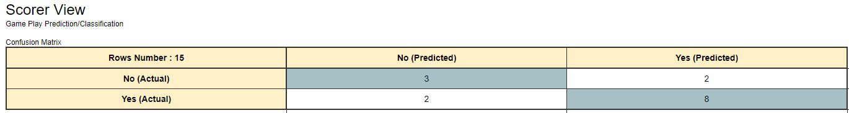
Accuracy
Accuracy
(Number of Times Predictions Were Correct Out of Total )
Numerator
Denominator
TP
True Positive
FP
False Positive
Actual Play = Yes
Actual = No
Total Valid Predictions
Total Predictions/Rows
Play = Yes
Predicted = Yes
FN
False Negative
TN
True Negative
TP + TN
TP + TN + FP + FN
Actual = Yes
Actual = No
Predicted = No
Predicted = No
Accuracy =
TP + TN
=
8 + 3
= 73%
TP + TN + FP + FN
8 + 3 + 2 + 2
TN
FP
FN
TP

Slide 26
Precision
Precision
(How Accurately It Predicts Positives)
Numerator
Denominator
TP
True Positive
FP
False Positive
Actual Play = Yes
Actual = No
Play = Yes
Predicted = Yes
Total True Positives Predictions
Total Positive Predictions
FN
False Negative
TN
True Negative
TP
TP + FP
Actual = Yes
Actual = No
Predicted = No
Predicted = No
Precision
TP
=
8
= 80%
TP + FP
8 + 2
TN
FP
FN
TP

Slide 27
Recall
Recall
(How Much of Positives it Accurately Predicts Out of Total Positives)
Numerator
Denominator
TP
True Positive
FP
False Positive
Actual Play = Yes
Actual = No
Total True Positives
Predictions
Total Actual Positives
Play = Yes
Predicted = Yes
FN
False Negative
TN
True Negative
TP
FN + TP
Actual = Yes
Actual = No
Predicted = No
Predicted = No
Recall
TP
=
8
= 80%
FN + TP
2 + 8
TN
FP
FN
TP

Slide 28
F Measure
F Measure
(Harmonic Mean of Perfection of Precision & Recall )
Numerator
Denominator
TP
True Positive
FP
False Positive
Actual Play = Yes
Actual = No
2 * Precision * Recall
Precision + Recall
Play = Yes
Predicted = Yes
FN
False Negative
TN
True Negative
2 * 0.8 * 0.8
0.8 + 0.8
Actual = Yes
Actual = No
Predicted = No
Predicted = No
F Measure
2 * Precision * Recall
=
2 * 0.8 * 0.8
= 66%
Precision + Recall
0.8 + 0.8
TN
FP
FN
TP

Slide 29
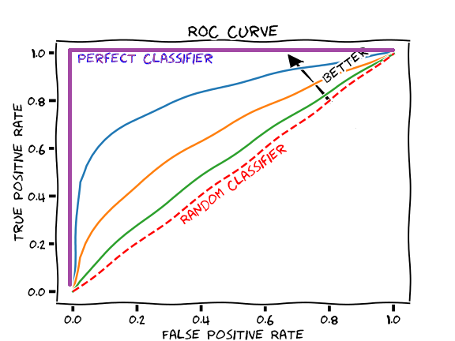
ROC – AUC Curve
AUC - ROC curve is a performance measurement for classification problems at various threshold settings.
ROC is a probability curve and AUC represents the degree or measure of separability.
It tells how much the model is capable of distinguishing between classes. The higher the AUC, the better the model is at predicting 0 classes as 0 and 1 classes as 1. By analogy, the Higher the AUC, the better the model is at distinguishing between the classes

Slide 30
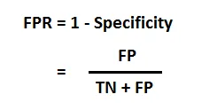


Terms in ROC-AUC
False Positive Rate
TPR (True Positive Rate) / Recall /Sensitivity
Specificity

Slide 31
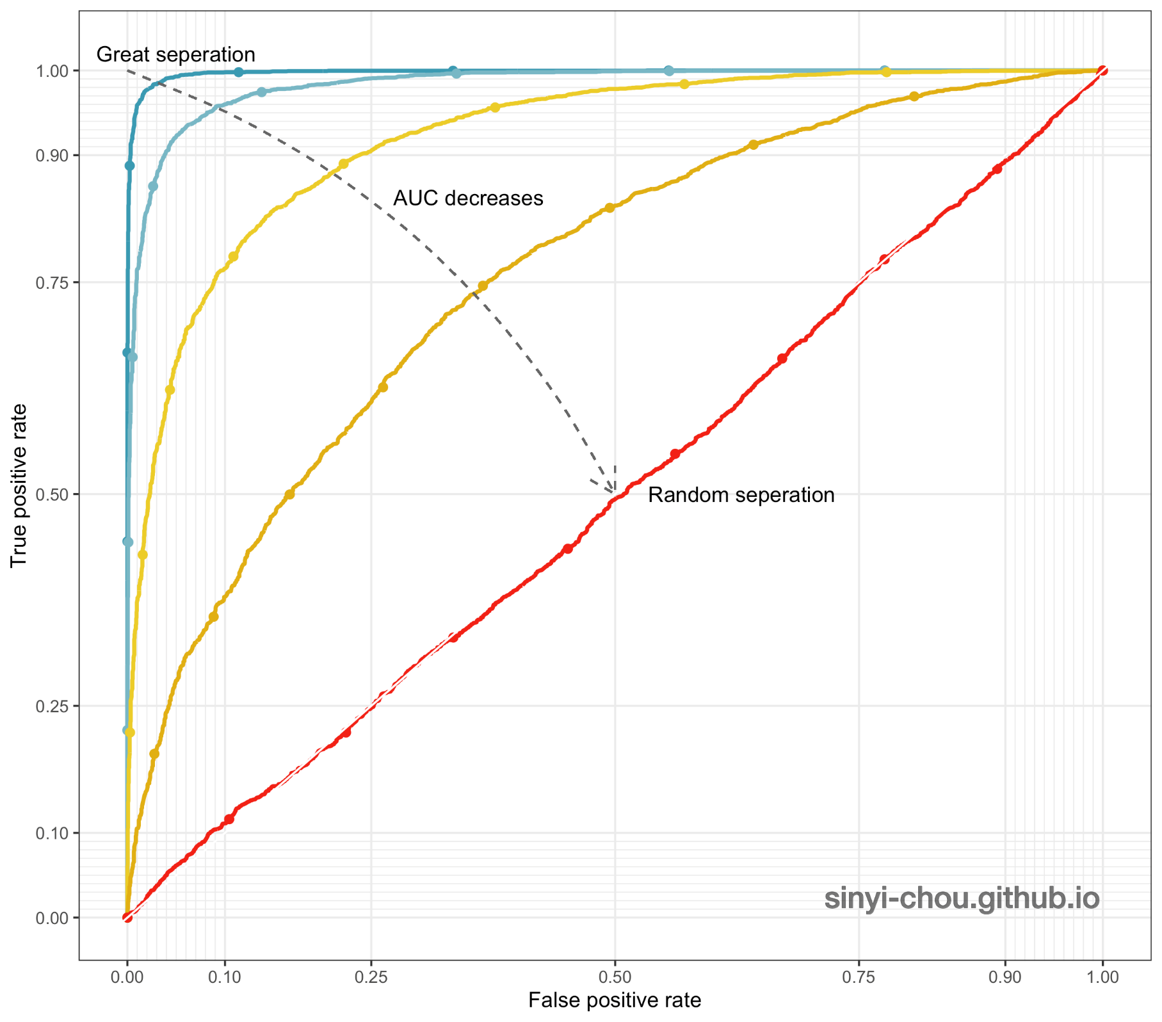
ROC – AUC Curve

Slide 32

THANK YOU
Training and Certification

